Slide 1

CS 410 / CS 560: Software Engineering
Software Engineering Management
Dr. Mohammed Ayoub Alaoui Mhamdi
Bishop's University
Sherbrooke, Qc, Canada
malaoui@ubishops.ca
Notes:
© SE, Introduction, Hans van Vliet

Slide 2
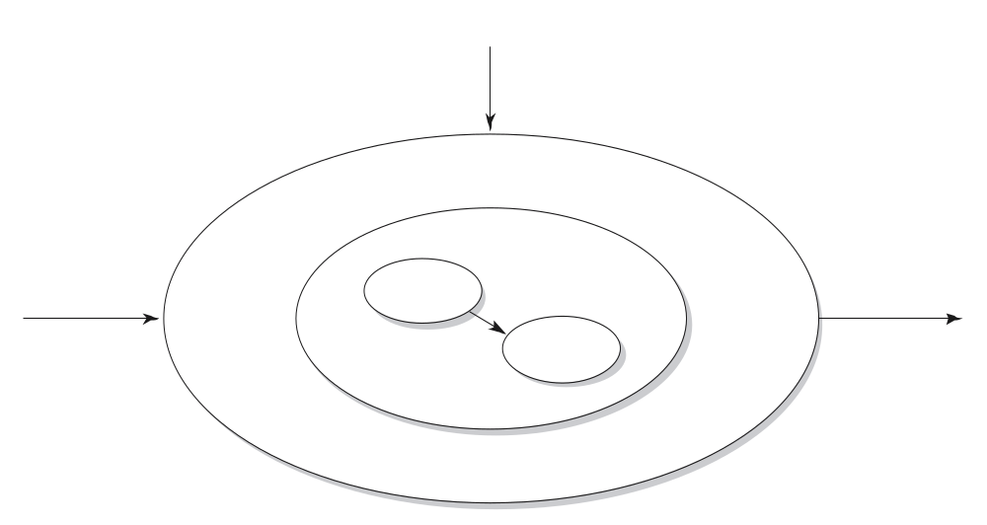
A broader view on software development
information planning
boundary conditions
documentation
people
software
input
program
output
program
procedures
Notes:
© SE, Management, Hans van Vliet

Slide 3
Example: information plan of a university registration of student data
Relations to other systems: personal data, courses, course results, alumni, …
Use both by central administration, at faculty level, and possibly by students themselves
Requires training courses to administrative personnel
Authorization/security procedures
Auditing procedures
External links, e.g. to scholarship funding agencies, ministry of education

Slide 4
Contents of project plan
Introduction
Process model
Organization of project
Standards, guidelines, procedures
Management activities
Risks
Staffing
Methods and techniques
Quality assurance
Work packages
Resources
Budget and schedule
Changes
Delivery
Notes:
© SE, Management, Hans van Vliet
Process model = life cycle model
Organization: relationships to other parts of the organization, roles of people, user involvement
Risks: e.g. hardware not in time, critical information to be provided by customer
Staffing: different amounts of people needed at different points in time
Work packages: work breakdown structure
Changes: procedures on how to handle them

Slide 5
Project control
Time, both the number of man-months and the schedule
Information, mostly the documentation
Organization, people and team aspects
Quality, not an add-on feature; it has to be built in
Money, largely personnel
Notes:
© SE, Management, Hans van Vliet

Slide 6
Managing time
Measuring progress is hard (“we spent half the money, so we must be halfway”)
Development models serve to manage time
More people ⇒ less time?
  Brooks’ law: adding people to a lae project makes it later

Slide 7

Managing information
Documentation
  Technical documentation
  Current state of projects
  Changes agree upon
  …
Agile projects: less attention to explicit documentation, more on tacit knowledge held by people
Notes:
understood or implied without being stated.
"your silence may be taken to mean tacit agreement"
© SE, Introduction, Hans van Vliet

Slide 8

Managing people
Managing expectations
Building a team
Coordination of work

Slide 9

Managing quality
Quality has to be designed in
Quality is not an afterthought
Quality requirements often conflict with each other
Requires frequent interaction with stakeholders

Slide 10
Managing cost
Which factors influence cost?
What influences productivity?
Relation between cost and schedule

Slide 11
Summary
Project control concerns
  Time
  Information
  Organization
  Quality
  Money
Agile projects do less planning than document-driven projects

